Slide 1
ph
- Marginean Denisa-Roxana -

Slide 2
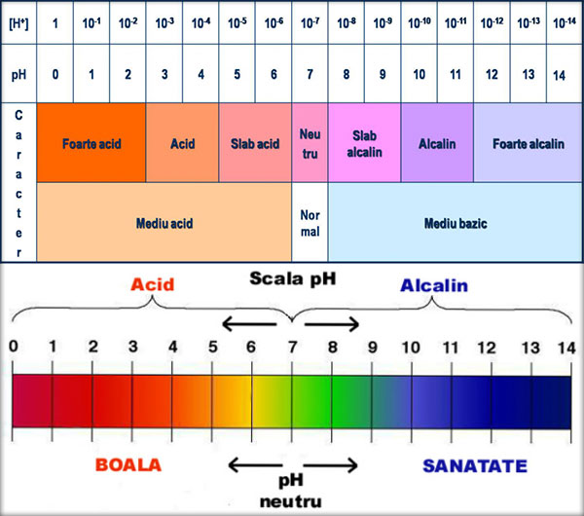

Slide 3
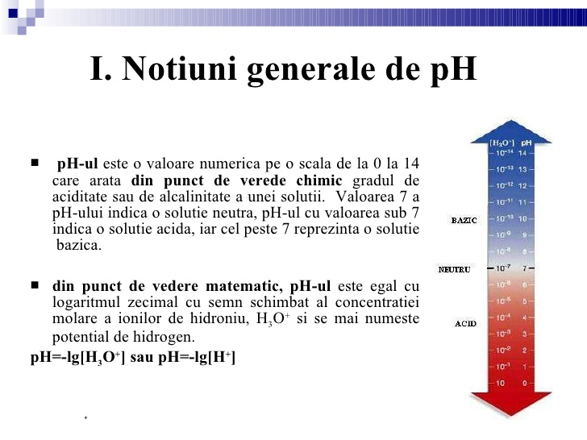

Slide 4
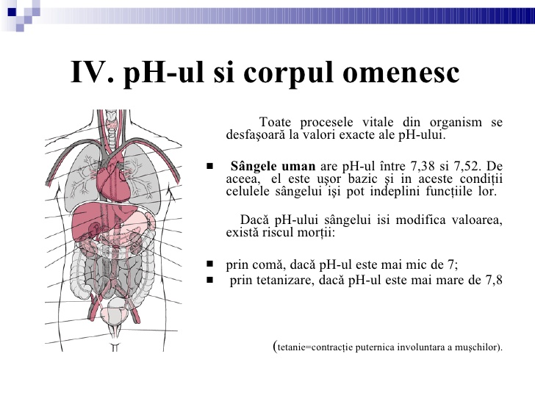

Slide 5


